Slide 1
Well Come

Slide 2
Shivaji University, Kolhapur
Department of Statistics Seminar on
“Eigenfaces Algorithm”
Presented by
Sable Vinayak Machhindra MSc.I Statistics Sem(1I) Under the Guidance of Dr. S.B.Mahadik
2017-2018

Slide 3
Introduction
Over the last ten years or so, face recognition has become a popular area of research in computer vision and one of the most successful applications of image analysis and understanding. Because of the nature of the problem, not only computer science researchers are interested in it, but neuroscientists and psychologists also.
One of the simplest and most effective PCA approaches used in face recognition systems is the so-called eigenface approach. This approach transforms faces into a small set of essential characteristics, eigenfaces, which are the main components of the initial set of learning images (training set).
Eigenfaces is the name given to a set of eigenvectors when they are used in the computer vision problem of human face recognition. The eigenvectors are derived from the covariance matrix of the probability distribution over the high-dimensional vector space of face images. The eigenfaces themselves form a basis set of all images used to construct the covariance matrix. This produces dimension reduction by allowing the smaller set of basis images to represent the original training images. Classification can be achieved by comparing how faces are represented by the basis set.

Slide 4
What is face recognition ?
Basic concept , Every person’s face has many features that are unique to that specific person.
Shares an lot in common with other Biometric systems.
Face Detection vs Face Recognition
(Face/Non-Face) (Identify who’s face among all images)
Two types of comparison
1.Face Verification – Basically a yes /no decision.
2.Face Identification – Identify from a database

Slide 5
Type Of Face Recognition
Based On Local Regions
Local Feature Analysis(LFA)
Gabor Wavelet
Based On Local Regions
Principal Component Analysis(PCA)
Independent Component Analysis(ICA)

Slide 6
Eigenfaces approach
Eigenfaces are the eigenvectors of covariance matrix of the dataset.
Eigenfaces are also referred to as ghostly images.
Prime reason, to represent the input data efficiently each individual face can be represented in terms of linear combination of eigenfaces.
Need to reduce dimensionality-
Principal Component Analysis (PCA)

Slide 7
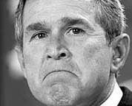
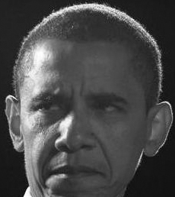
Principal component analysis
Used to remove information which is not useful. Therefore it reduces the dimension of the data and accurately decompose the face structure into orthogonal principal components which we know as eigenfaces.
Face space forms a cluster -PCA gives suitable representation.

Slide 8
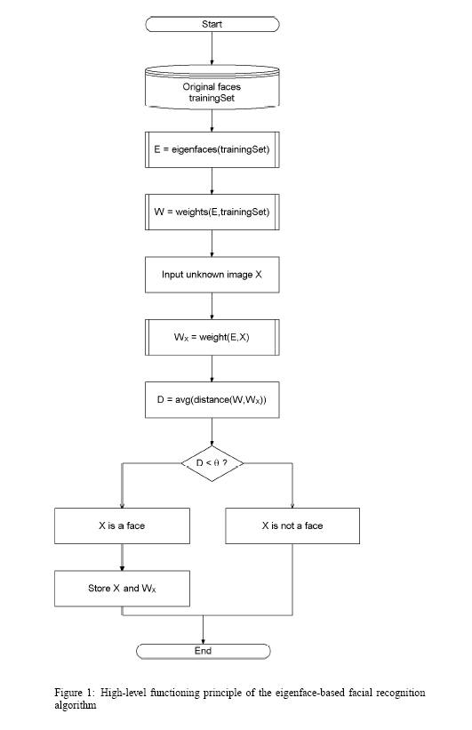
Face Recognition – Flow Chart

Slide 9
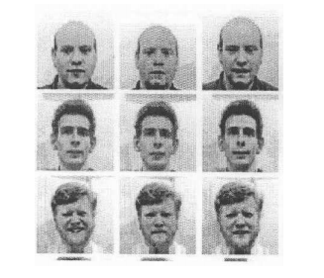
Computation Of The Eigenfaces
Step 1: Obtain face images I₁, I₂,..., I_{M} (training faces)
(Very important: The Face Images Must Be Centred And Of The Same Size)

Slide 10
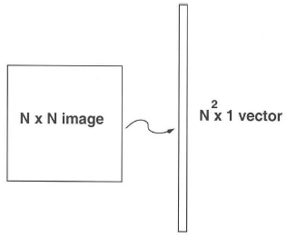
Step 2: Represent every image I_{i} as a vector Γ_{i}

Slide 11

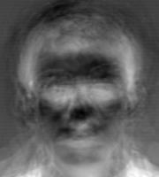
Step 3: Compute the average face vector Ψ:
Step 4: Subtract the mean face:
Φ_{i} =Γ _{i}−Ψ

Slide 12

Step 5: Compute the covariance matrix C:

Slide 13
Step 6: Compute the eigenvectors u_{i} of AA^{T}
The matrix AA^{T} is very large --> not practical !!
Step 6.1: Consider the matrix A^{T} A (M x M matrix)
Step 6.2: Compute the eigenvectors v_{i} of A^{T} A
A^{T} Av_{i} =µ_{i}v_{i}
What is the relationship between u_{i} and v_{i}?
A^{T}Av_{i}=µ_{i}v_{i} => AA^{T}Av_{i} =µ_{i}Av_{i}
=>CAv_{i} =µ_{i} Av_{i} or Cu_{i} =µ_{i}u_{i}
where u_{i}= Av_{i}
Thus, AA^{T} and A^{T}A have the same eigenvalues and their eigenvectors are related as follows: u_{i} = Av_{i} !!

Slide 14
Note 1: AA^{T} can have up to N² eigenvalues and eigenvectors.
Note 2: A^{T}A can have up to M eigenvalues and eigenvectors.
Note 3: The M eigenvalues of A^{T} A (along with their corresponding eigenvectors) correspond to the M largest eigenvalues of AA^{T} (along with their corresponding eigenvectors).
Step 6.3: Compute the M best eigenvectors of AA^{T}: u_{i} = Av_{i}
(important: normalize u_{i} such that||u_{i}|| = 1)
Step 7: Keep only K eigenvectors (corresponding to the K largest eigenvalues)

Slide 15
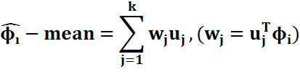
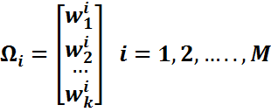
Representing Faces Onto This Basis
Each face (minus the mean) φ_{i} in the training set can be represented as a linear combination of the best K eigenvectors:
(we call the u_{j} ‘s eigenfaces)
Each Normalized Training Face Φ_{i} Is Represented In This Basis By A Vector:

Slide 16


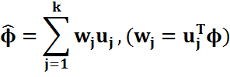
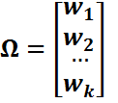
Face Recognition Using Eigenfaces
Input image of unknown person
Convert the input image to a face vector
Normalize this Face vector
Φ=Γ−Ψ
YES
If
Dist. < threshold
Project normalize face vector onto the Eigenfaces
NO
UNKNOWN
PERSON
Recognized as
Wight vector of input image
Calculate “Distance” between input weight vector and all the weight vectors of training set.
||Ω_{i} - Ω||²

Slide 17
Application Of Eigenfaces
Handwriting Recognition.
Lip Reading.
Voice Recognition.
Sign Language/Hand Gestures Interpretation.
Medical Imaging Analysis.

Slide 18
Limitations
Background changes cause problems
Light changes degrade performance
Performance decreases quickly with changes to face size
Multi-scale eigenspaces.
Scale input image to multiple sizes.
Performance decreases with changes to face orientation (but not as fast as with scale changes)
Plane rotations are easier to handle.
Out-of-plane rotations are more difficult to handle.

Slide 19
References:
M. Turk,A. Pentland (1991);"Eigenfaces for recognition" , Journal of Cognitive Neuroscience. 3 (1): 71–86. doi:10.1162/jocn.1991.3.1.71. PMID 23964806.

Slide 20
Thank you

